Slide 1
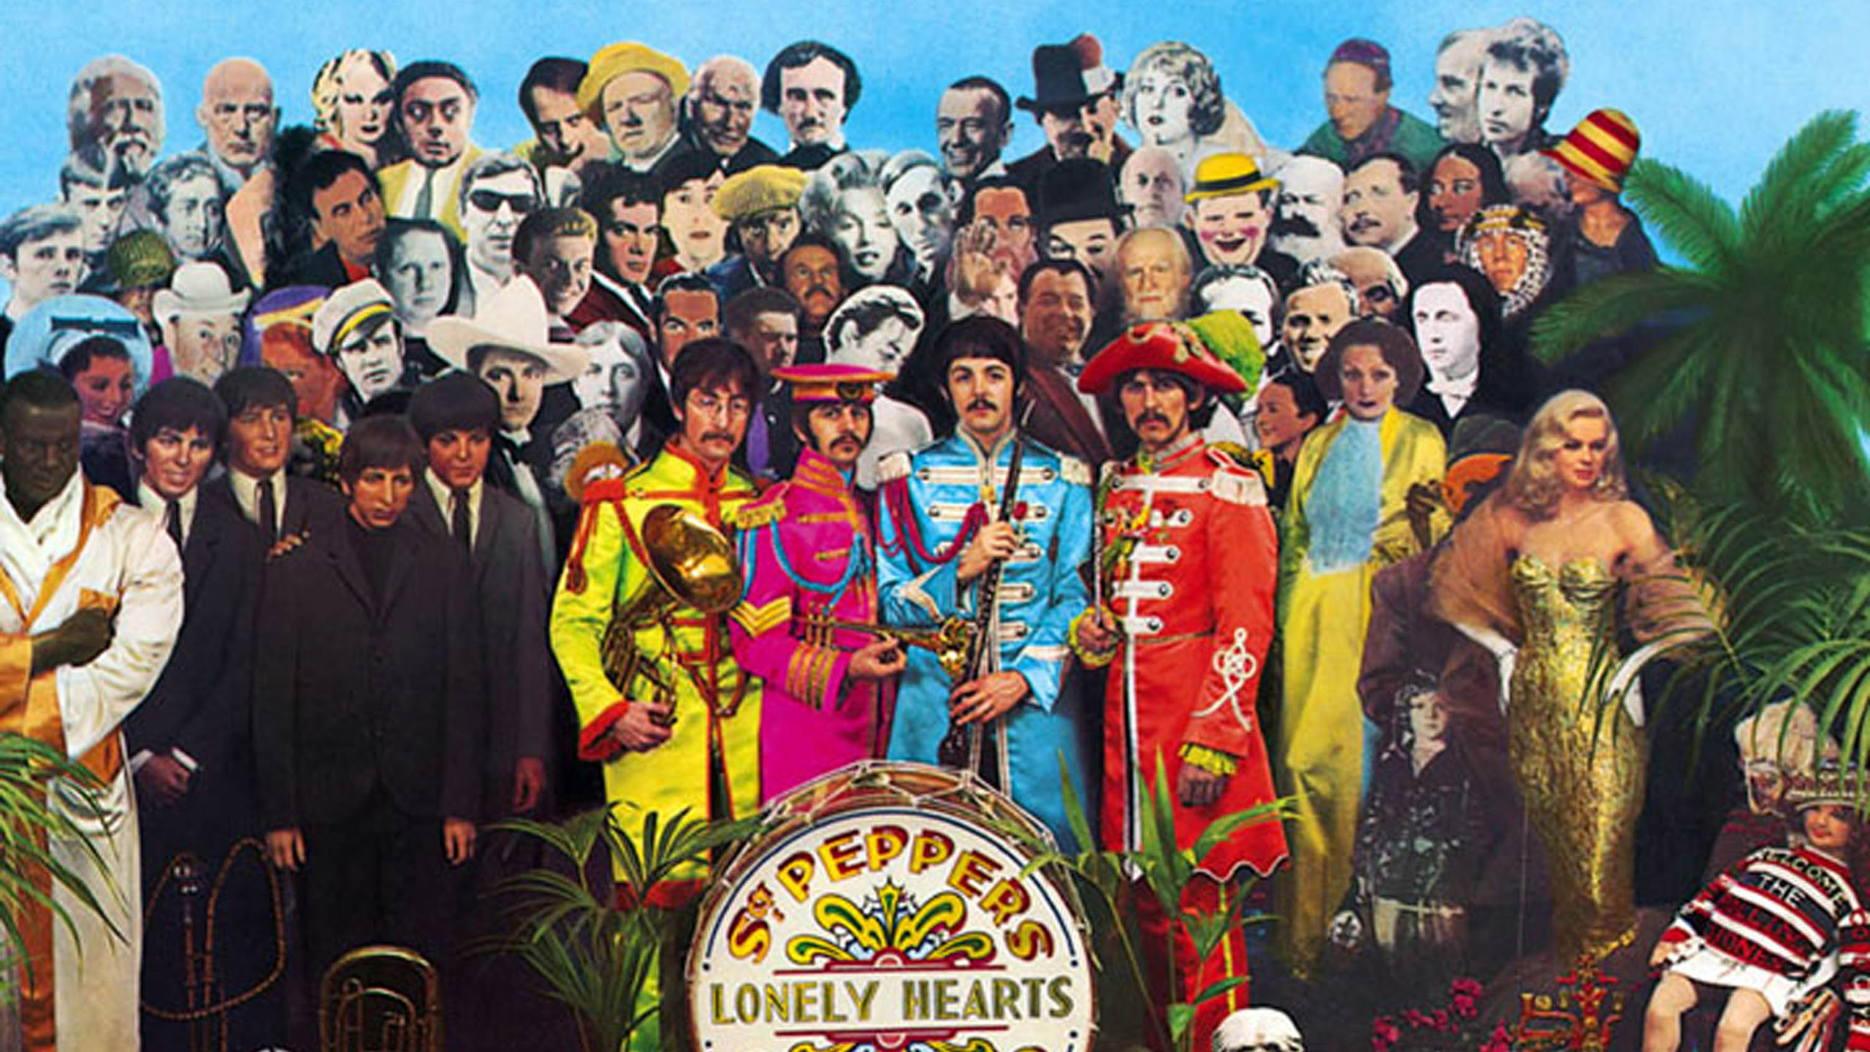
I git by with a little help from my friends
Git and Github for beginners

Slide 2
✅ What is git?
✅ What’s the diff between git, GitHub and GitLab?
✅ How do you do git?
✅ Gitty-up: how can we collaborate with git?
✅ What kinds of projects can we use git with?
✅ The expansion pack: GitHub Pages, GitHub Desktop, and GitLab

Slide 3

What is git?

Slide 4

Git is a tool on your computer that lets you keep a history of your team’s work and collaborate more effectively

Slide 5
What’s the difference between git, GitHub, and GitLab?

Slide 6


Git
GitHub
A tool local to your computer only
A backup and collaboration space with ability to publish websites

Slide 7
Git
GitHub
LOCAL
REMOTE

Slide 8
Git
GitHub
What you use to work on files locally, on your computer
Where you get files from other people that you can work on

Slide 9

May 18
May 19
May 20
May 21
With git you can step backwards or forwards in time to see your project history

Slide 10


GitHub
GitLab
Open source, free publishing for git projects, shared publicly
Open source publishing for git projects in enterprise orgs (like gov), shared privately

Slide 11
How do you do git?

Slide 12
First, you need a project to work on:
Create a project
Notes:
You can go to Github to find open source projects that you can work on as a collaborator

Slide 13
First, you need a project to work on:
Create a project
Collaborate on someone else’s project
Notes:
You can go to Github to find open source projects that you can work on as a collaborator

Slide 14

A project that uses git and is shared on GitHub is called a repository or repo.

Slide 15
A project that uses git and is shared on GitHub is called a repository or repo.
It’s basically a fancy name for a project folder and its files.

Slide 16
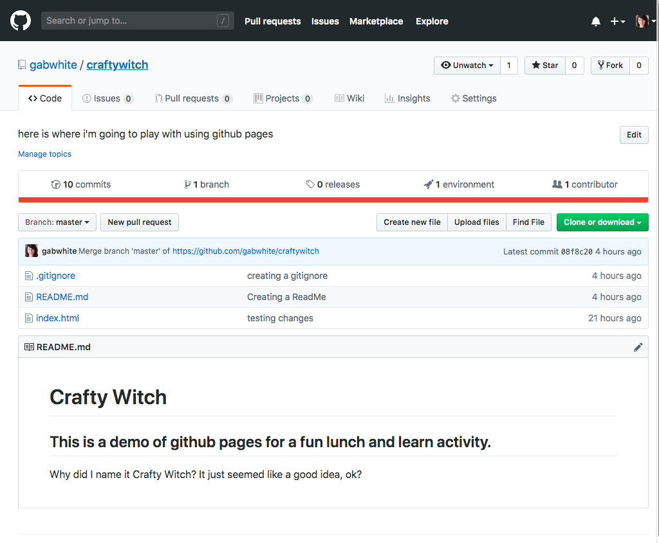
Let’s see how we would collaborate on a project that already exists
https://github.com/gabwhite/craftywitch

Slide 17

Cloning someone else’s repo lets you keep a copy of it on your own computer that you can edit.

Slide 19
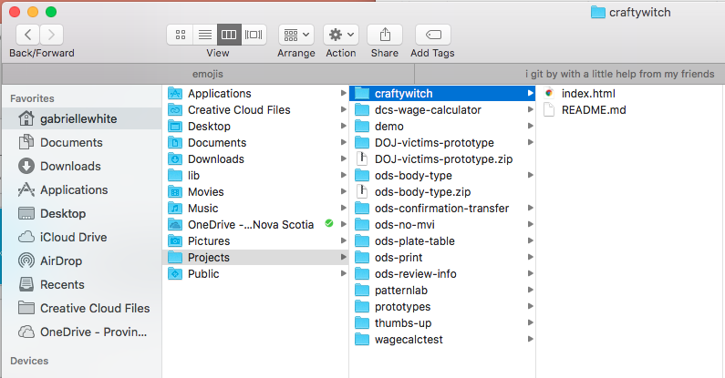
You use git to tell your computer to clone the repository from GitHub to give you a copy you can work on

Slide 20
Edit and save files in your local git repo as you would normally
You don’t need to rename files

Slide 21
Edit and save files in your local git repo as you would normally
You don’t need to rename files
After you’ve made a few edits to some files, you should commit your changes

Slide 22

A commit is a snapshot of your repository at a point in time

Slide 23
Commit 1
Commit 2
Commit 3
Commit 4
Git commits help you go back to a specific point in time.
Commit often to keep track of all your work.

Slide 24

Commit 1
Commit 2
Commit 3
Commit 4
Git commits help you go back to a specific point in time.
Commit often to keep track of all your work.

Slide 25

Commit 1
Commit 2
Commit 3
Commit 4
Git commits help you go back to a specific point in time.
Commit often to keep track of all your work.

Slide 26
When you make a commit, git keeps track of:
Whodunnit (username)

Slide 27
When you make a commit, git keeps track of:
Whodunnit (username)
When they committed to the repo

Slide 28
When you make a commit, git keeps track of:
Whodunnit (username)
When they committed to the repo
What was changed

Slide 29
When you make a commit, git keeps track of:
Whodunnit (username)
When they committed to the repo
What was changed
Your commit message

Slide 30


A good commit message
Explains what changed

Slide 31
A good commit message
Explains what changed
Explains why you changed something

Slide 32

But most importantly:
It helps your team communicate and be better collaborators

Slide 33

Bad commit message
“added some links to stuff”

Slide 34

Bad commit message
Good commit message
“added a table of contents page with links to sections because scroll was too long”
“added some links to stuff”

Slide 35
Your commits are only saved on your computer
To share the work you’ve committed with the whole project team, you need to push your commits to a shared place like GitHub or GitLab

Slide 36
What’s happening when you push your commits?
Git tells GitHub that someone has changes that they want to include in the shared repo

Slide 37
What’s happening when you push your commits?
Git tells GitHub that someone has changes that they want to include in the shared repo
And then GitHub is like, “…wait.”

Slide 38

If everyone could push their local work to the shared repo all willy-nilly, things would get super messy, super fast.
To publish your changes in the shared repo, you have to make a pull request.

Slide 39
A pull request lets someone else from your project review your work before it gets merged into to the shared repo
Yay peer review!

Slide 40
When your pull request is merged, other people can now pick up where you left off with your work.

Slide 41


But what if…
More than 1 person wants to work on the same file?
Notes:
It’s a tricky situation. 1 person could accidently overwrite someone elses work. When the changes get submitted to gihub, git won’t know who’s changes are the ones that should be kept

Slide 42
You might confuse GitHub and accidently overwrite your collaborator’s work
Notes:
It’s a tricky situation. 1 person could accidently overwrite someone elses work. When the changes get submitted to gihub, git won’t know who’s changes are the ones that should be kept

Slide 43
Gitty-up: how can we collaborate with git?

Slide 44
Master Commit 1
Master
Commit 2
Master Commit 3
Master
Commit 4
Enter: branches
Every project starts with a master branch

Slide 45
Master Commit 1
Master
Commit 2
Master Commit 3
Master
Commit 4
Enter: branches
Every project starts with a master branch
Master is the “queen” branch

Slide 46

Master Commit 1
Master
Commit 2
Master Commit 3
Master
Commit 4
Everything on “master” should be tested and in production.

Slide 47
Master Commit 1
Master
Commit 2
Master Commit 3
Master
Commit 4
Everything on “master” should be tested and in production.
So how do we build new stuff without breaking master?

Slide 48
Master
Commit 1
Master Commit 2
Master
Commit 3
Master Branch
Keep master stable with branches.
Notes:
Our goal should be to keep the master branch stable and only have content/code in here that is ready for production

Slide 49

Gab Branch
Master
Commit 1
Master Commit 2
Master
Commit 3
Master Branch
Keep master stable with branches.
Notes:
If I want to work on the project and make some big changes, I need to make a separate branch where I can work on stuff safely

Slide 50
Gab Branch Commit 1
Gab Branch
Master
Commit 1
Master Commit 2
Master
Commit 3
Master Branch
Keep master stable with branches.
Every time you want to add a new feature to a project, create a new branch to edit in isolation.
Notes:
Gab’s branch is out of sync with master, so any crazy changes happening on Gab’s branch won’t impact what’s happening on master

Slide 51
Gab Branch Commit 1
Gab Branch Commit 2
Gab Branch
Master
Commit 1
Master Commit 2
Master
Commit 3
Master Branch
Keep master stable with branches.
Every time you want to add a new feature to a project, create a new branch to edit in isolation.
Notes:
Similar, Gab’s branch won’t be impacted by what is happening on master and won’t have any of the new changes that have been added to master

Slide 52

You can have many branches!
You can name them whatever you like!

Slide 53
You can have many branches!
You can name them whatever you like!
Your branches can have branches!

Slide 54

Gab Branch Commit 1
Gab Branch Commit 2
Gab Branch
Master Commit 2
Master
Commit 1
Master
Commit 3
Master Branch
Beth Branch Commit 1
Beth Branch Commit 2
Beth Branch
Notes:
Now we have 3 branches:
Master: the queen that is production ready
Gab’s branch
Beth’s Branch

Slide 55


Dev Branch Commit 1
Dev Branch Commit 2
Dev Branch
Master Commit 2
Master
Commit 1
Master
Commit 3
Master Branch
Master = production
Dev = still being worked on
Test = work that is in QA
Test Branch Commit 1
Test Branch Commit 2
Test Branch
Notes:
Here’s a strategy I’ve used in the past with a small team building a website
Master: the queen that is production ready
Dev: stuff that is still being worked on
Test: things that are ready for QA but still not fully cooked yet.

Slide 56

How do get your work from your branch onto master?
There are a few ways
The easiest way is the “pull then push”

Slide 57
Gab Branch Commit 1
Gab Branch Commit 2
Gab Branch
Master Commit 2
Master
Commit 1
Master
Commit 3
Master Branch
Beth Branch Commit 1
Beth Branch Commit 2
Beth Branch
Notes:
Now we have 3 branches:
Master: the queen that is production ready
Gab’s branch
Beth’s Branch

Slide 58
Gab branch is 1 commit behind master
Gab Branch Commit 1
Gab Branch Commit 2
Gab Branch
Master
Commit 1
Master Commit 2
Master
Commit 3
Master Branch
Beth Branch Commit 1
Beth Branch Commit 2
Beth Branch
Notes:
Let’s say Gab is ready to publish her work onto master
She is behind master by 1 commit, that means there is stuff on master that is not on gab’s branch
Don’t worry about beth
Gab has to catch up with master before she can merge

Slide 59
Pull from master to Gab branch
Gab Branch Commit 1
Gab Branch Commit 2
Gab Branch
Master
Commit 1
Master Commit 2
Master
Commit 3
Master Branch
Beth Branch Commit 1
Beth Branch Commit 2
Beth Branch
Notes:
Let’s say Gab is ready to publish her work onto master
She is behind master by 1 commit
Don’t worry about beth
Gab has to catch up with master before she can merge

Slide 60
Gab Branch Commit 1
Gab Branch Commit 2
Gab branch is caught up to Master
Gab Branch
Master
Commit 1
Master Commit 2
Master
Commit 3
Master Branch
Beth Branch Commit 1
Beth Branch Commit 2
Beth Branch
Notes:
Now gab is caught up with master and can safely merge

Slide 61
Gab Branch Commit 1
Gab Branch Commit 2
Gab branch is caught up to Master
Gab Branch
Master
Commit 1
Master Commit 2
Master
Commit 3
Push to master from Gab branch
Master Branch
Beth Branch Commit 1
Beth Branch Commit 2
Beth Branch
Notes:
To merge, I push my work from gab branch to master
I’ll need to make a pull request on github.com
Someone will review
And then gab branch will be safely merged
- Any code that was only on gab’s branch, is now on master

Slide 62
Gab Branch Commit 1
Gab Branch Commit 2
Gab branch is caught up to Master
Gab Branch
Master
Commit 1
Master Commit 2
Master
Commit 3
Push to master from Gab branch
Master Branch
Now we can safely delete Gab Branch
Beth Branch Commit 1
Beth Branch Commit 2
Beth Branch
Notes:
Deleting branches is healthy! Its like trimming trees

Slide 63
Master
Commit 1
Master Commit 2
Master
Commit 3
Push to master from Gab branch
Master Branch
Beth branch is behind by 2 commits
Beth Branch Commit 1
Beth Branch Commit 2
Beth Branch
Notes:
Now Beth is behind by two commits, because gab was just merged in
We can follow the same process as before

Slide 64
Master
Commit 1
Master Commit 2
Master
Commit 3
Push to master from Gab branch
Master Branch
Beth branch is behind by 2 commits
Pull from Master branch
Beth Branch Commit 1
Beth Branch Commit 2
Beth Branch
Notes:
Beth pulls from the master branch

Slide 65
Master
Commit 1
Master Commit 2
Master
Commit 3
Push to master from Gab branch
Master Branch
Beth Branch Commit 1
Beth Branch Commit 2
Beth branch is caught up to Master
Beth Branch
Notes:
Now beth is caught up with master

Slide 66
Push to master from Gab branch
Push to master from Beth branch
Master
Commit 1
Master Commit 2
Master
Commit 3
Master Branch
Beth Branch Commit 1
Beth Branch Commit 2
Beth branch is caught up to Master
Beth Branch
Notes:
Beth can safely push to master

Slide 67
What kinds of projects can we use git with?

Slide 68

Git works well in projects that are collaborative and evolving:
Anything code-related that multiple people are iterating on

Slide 69
Git works well in projects that are collaborative and evolving:
Anything code-related that multiple people are iterating on
Stuff you want to publish via GitHub pages and share with the world

Slide 70
Git works well in projects that are collaborative and evolving:
Anything code-related that multiple people are iterating on
Stuff you want to publish via GitHub pages and share with the world
Stuff you want people to contribute to and provide feedback on

Slide 71
You can use any file type with git, but most often git is used to track code files or simple markdown or txt files

Slide 72
Let’s look at examples
Ontario Service Standard
Gov UK Child Benefit Tax Calculator

Slide 73
How might we…
Nova Scotia Service Manual
Eligibility Checker

Slide 74
The expansion pack: GitHub Pages, GitHub Desktop, and GitLab

Slide 75
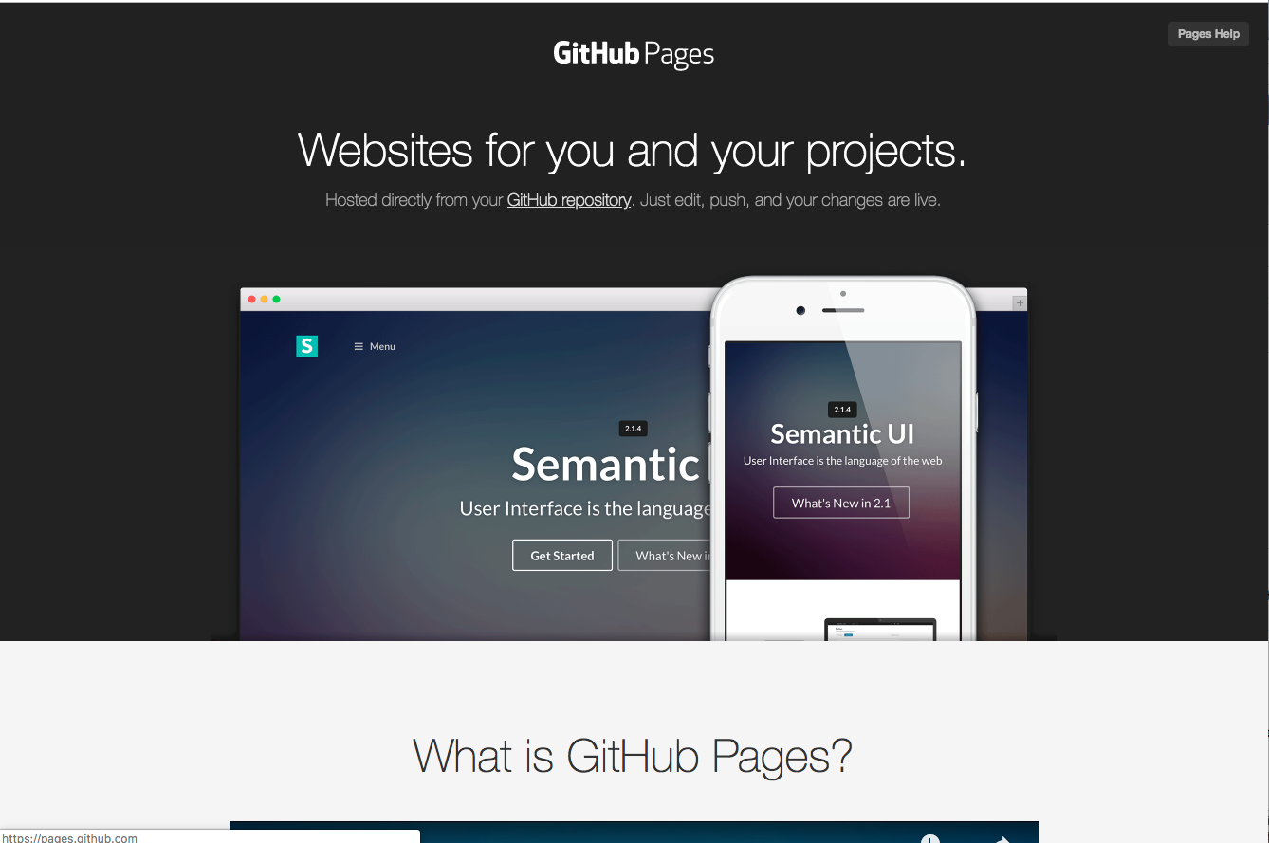
Github pages lets you host the content in your repo directly on Github for the whole world to see
https://pages.github.com/

Slide 76
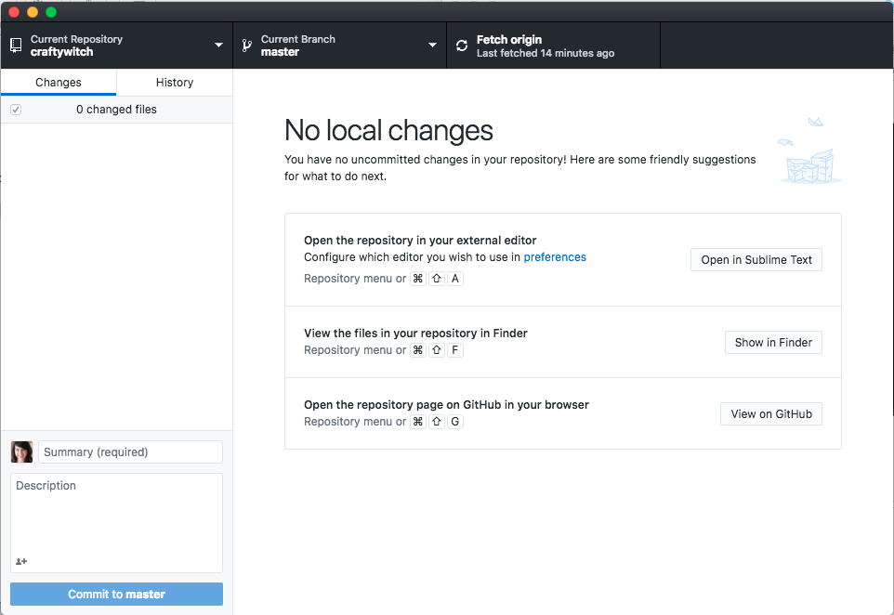
Github Desktop is free app (yes, you can actually download it) and is an easy interface for working on git projects
https://desktop.github.com/

Slide 77
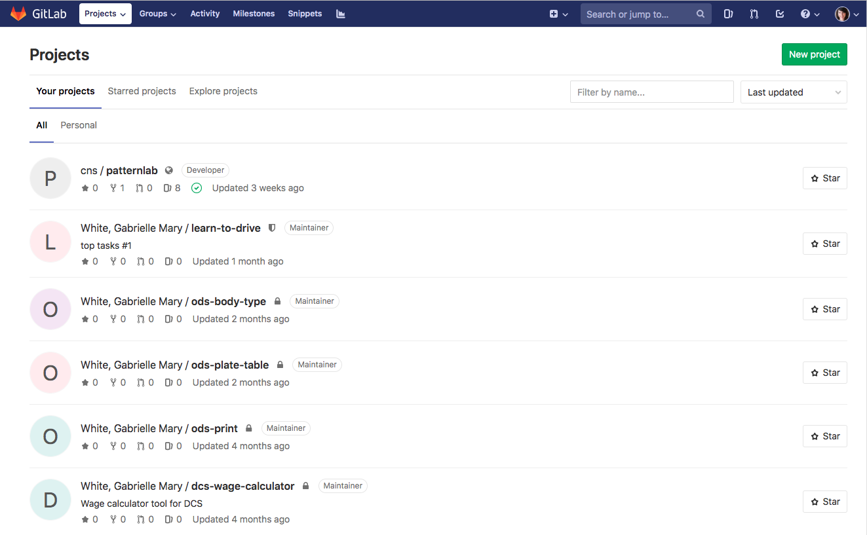
If you don’t want your project to be public, you can use GitLab* to collaborate with fellow NS gov peeps
https://gitlab.novascotia.ca/
*Except you can’t use GitHub Desktop with GitLab, but you can use GitKraken

Slide 78

That’s it.

Slide 79
Shoutout to:
Git for humans by Alice Bartlett and Beth for recommending!
Andrew for peer reviewing the notes

Slide 80
Questions??????

